Slide 1
AIDA- The Virtual Voice Assistant
Guide:
Sooraj T R
Head of the Department
Computer Science and Engg.
Team Members:
Abhin Jose
Asif Ali Najeeb
Diya Ajithkumar
Jasna Sara John

Slide 2
INTRODUCTION
“AIDA”- AI-based virtual assistant, operates via text and voice commands for windows-based systems.
Helps with day-to-day activities like searching in Wikipedia.
Provides opens/closes app system, sets alarms and remainders.
More commands can be added in future updates
Simplifies communication with a computer system.
Helps in minimizing the utilization of time.
Designed for old aged and visually impaired people

Slide 3
SYSTEM ARCHITECTURE DESIGN
USER
COMMANDS
SYSTEM
CONTROL
OPEN
COMMON
WEBSITES
SEND MESSAGES IN WHATSAPP
SEARCH PLACES ON MAP
SEARCH IN WIKIPEDIA
NEWS HEADLINES
JOKES
PLAY AUDIOS AND VIDEOS
WRITE NOTES
TELL TIME

Slide 4
ALGORITHM
Step 1: START.
Step 2: Import the necessary libraries and modules for speech recognition and NLP functionalities.
Step 3: Initialize the virtual voice assistant and greet the user. Set up the speech recognition module to listen for user input.
Step 4: Convert the user's speech into text using a speech-to-text library or API.
Step 5: Pass the user's text input to the NLP module for further processing. Use NLP techniques to extract intent and entities from the user's input.
Step 6: Based on the intent or command, execute the corresponding action or retrieve the required information.
Step 6.1: If the user's intent requires further clarification or information, prompt the user for additional details.
Step 6.2: If the user's intent is not recognized or understood, provide a default response or ask the user to rephrase.
Step 7: Convert the virtual assistant's response to speech using a text-to-speech module or API.
Step 8: Play the response to the user.
Step 9: Repeat steps 3-8 until the user indicates they want to exit the program.
Step 10: Provide a closing message and terminate the program.
Step 11: STOP

Slide 5
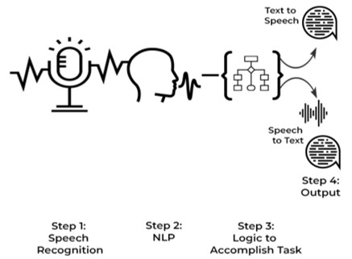
WORKING DESIGN OF ‘AIDA’

Slide 6
IMPLEMENTATION
Project is written in python and done in PyCharm.
Python modules are used for implementing different functions.
Modules such as pyttsx3, SpeechRecognition, wikipedia, pyjokes,pyaudio, Random, requests, datetime, webbrowser, pywhatkit, subprocess, ctypes ,openai.
‘Pyttsx3’ is used to convert text to speech,
‘SpeechRecognition’ is used to recognize the speech,
‘Wikipedia’ is to perform the searches in wikipedia,
‘pyjokes’ provides jokes in python, ‘datetime’ is to import system date and time, webbrower used for web browsing.
‘Subprocess’ module used to open and close certain applications.

Slide 7
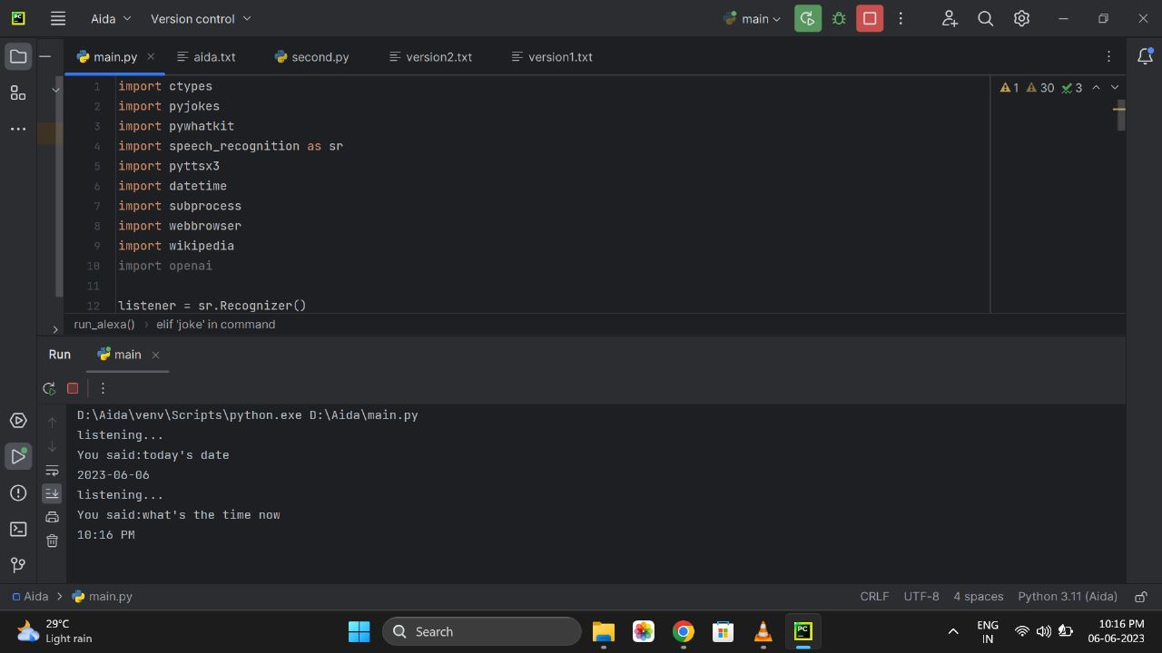
OUTPUTS

Slide 8
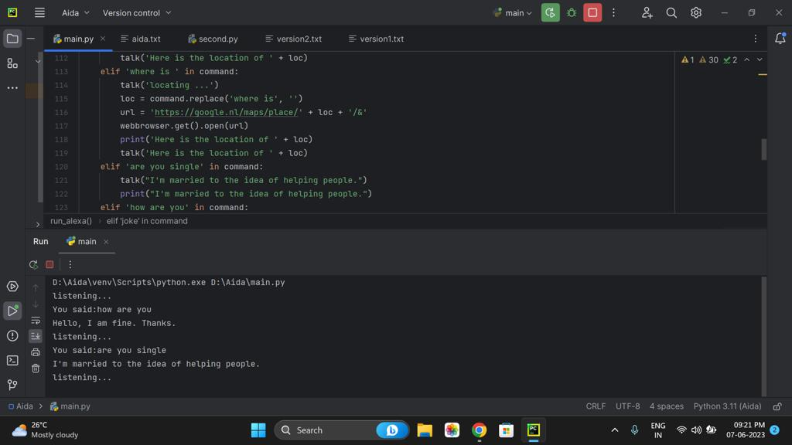
Simple queries

Slide 9
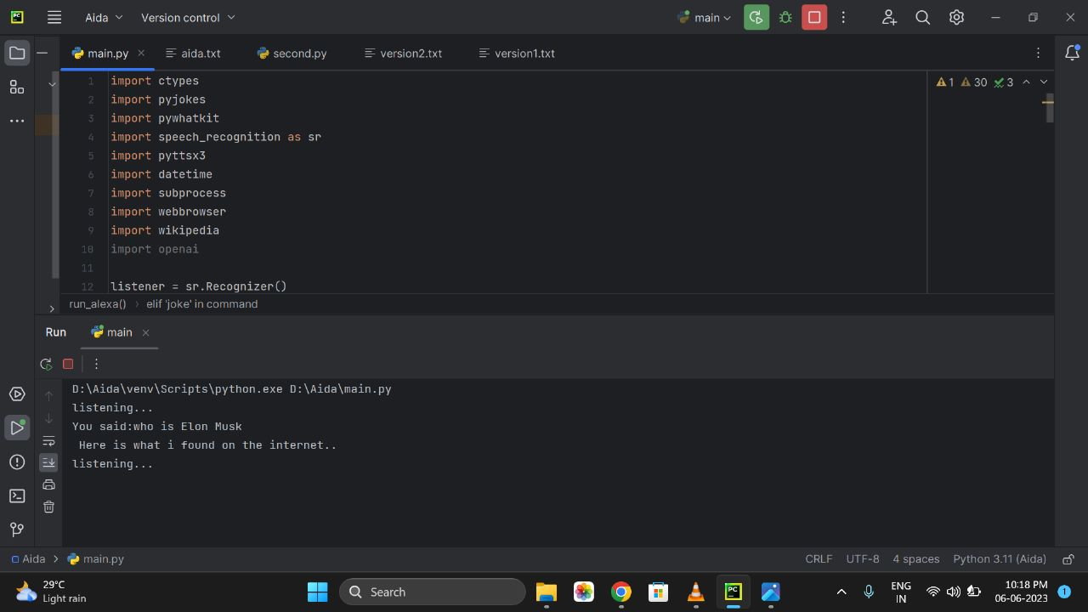
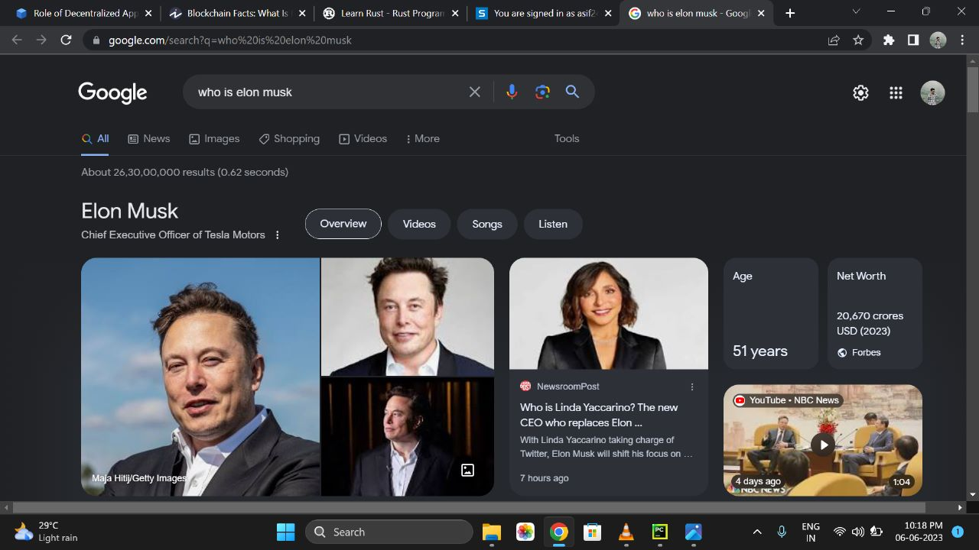

Slide 10
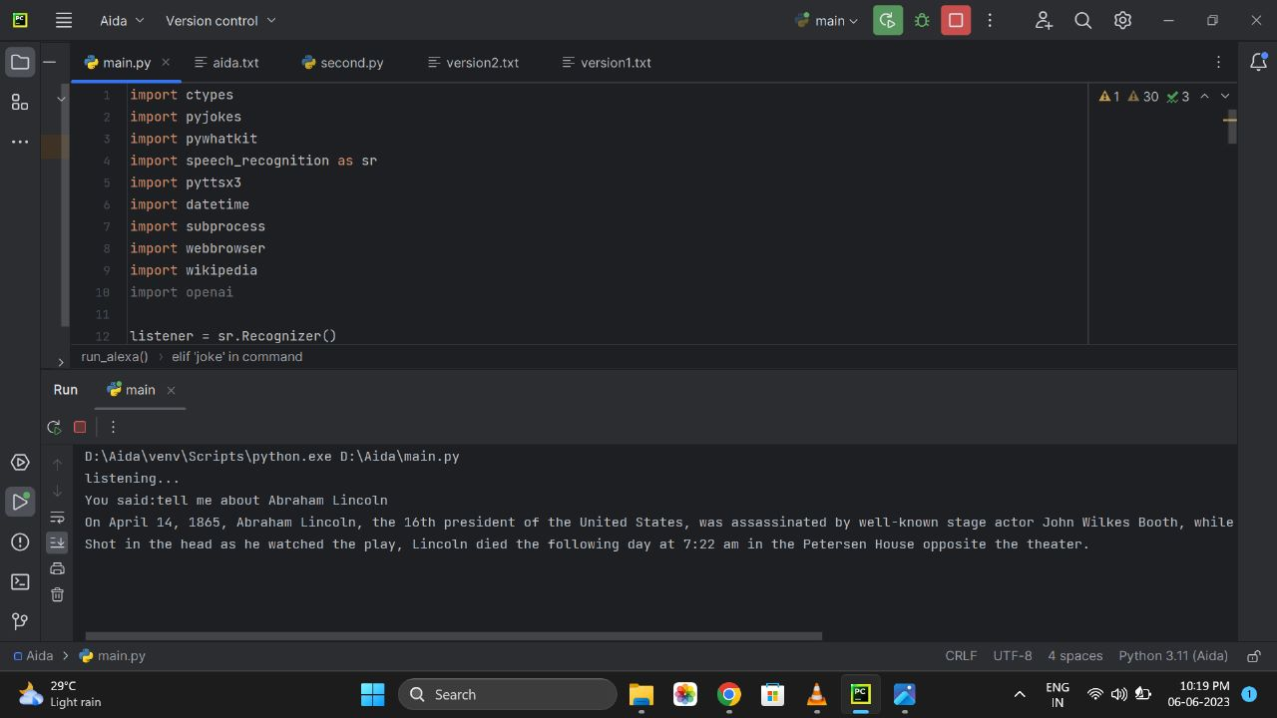

Slide 11

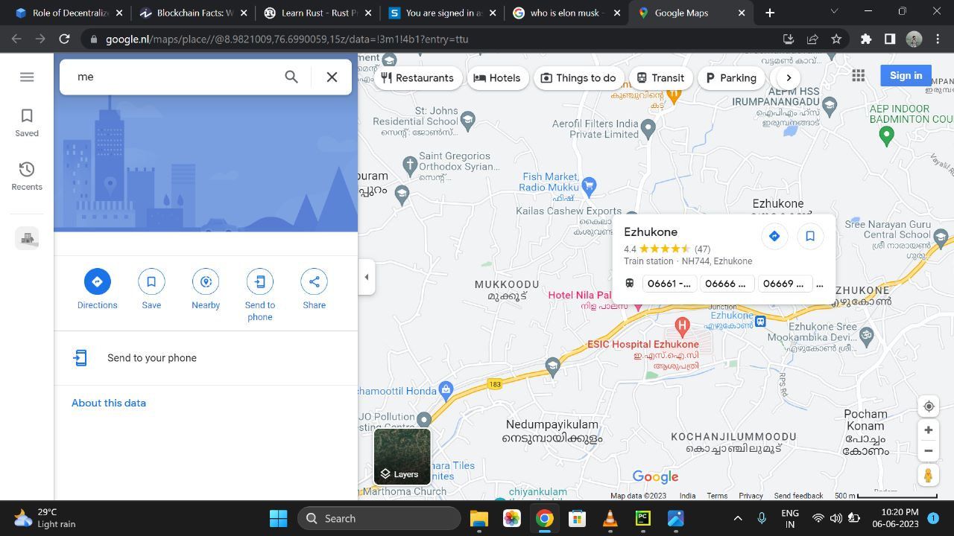
Finding locations

Slide 12
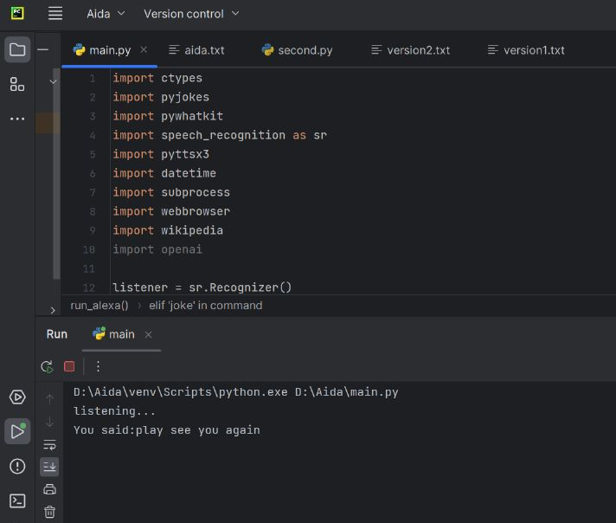
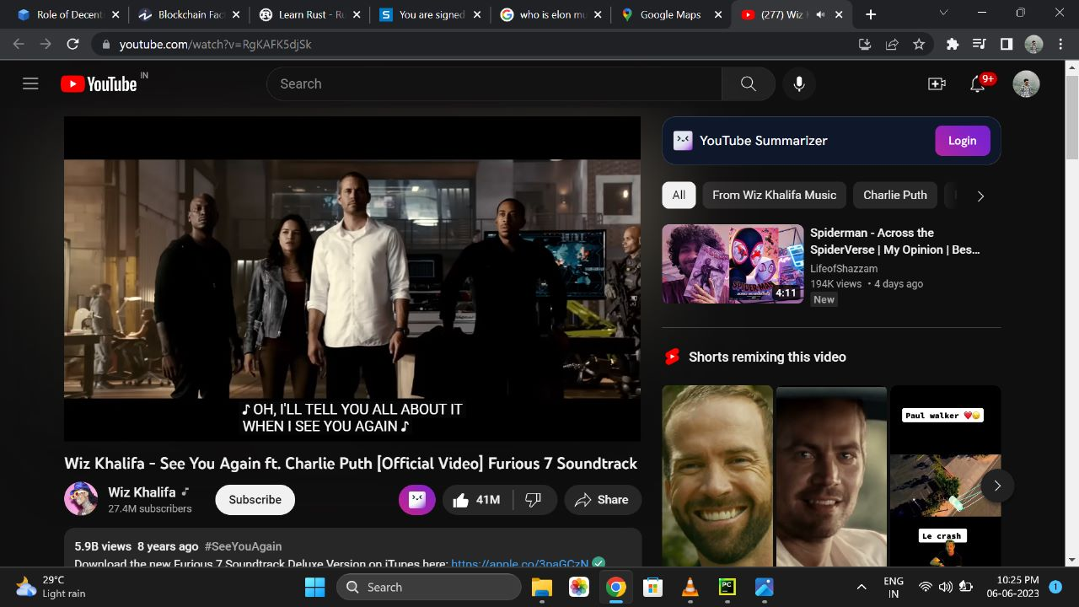
Playing YouTube Videos

Slide 13
CONCLUSION
The project “AIDA” is developed to overcome almost all the disadvantages of the existing system.
The system has been designed to improve the efficiency and simplify the operations performed.
The mass adoption of artificial intelligence in user’s everyday lives is also fueling the shift towards voice.
The number of IoT devices such as smart thermostats and speakers are giving voice assistants more utility in a connected user’s life.

Slide 14
REFERENCES
Websites and papers referred –
"Virtual Voice Assistant In Python (Friday)," 2022 IEEE 4th International Conference on Cybernetics, Cognition and Machine Learning Applications (ICCCMLA), Goa, India, 2022
https://ieeexplore.ieee.org/stamp/stamp.jsp?tp=&arnumber=9989099&isnumber=9988754
"An Intelligent Virtual System using Machine Learning," 2022 IEEE IAS Global Conference on Emerging Technologies (GlobConET), Arad, Romania, 2022
https://ieeexplore.ieee.org/stamp/stamp.jsp?tp=&arnumber=9872396&isnumber=9872325
www.stackoverflow.com
www.pythonprogramming.net
www.codecademy.co
www.tutorialspoint.com
YouTube Channels referred -
CS Dojo
Edureka

Slide 15
THANK YOU

